Slide 1
Web development
D a y 2
By Rajdeep Karmakar

Slide 2
Today’s Topics:
There’s what you’ll find in this Slidesgo template:
DNS
IP address
VS code installation
git installation

Slide 3
01
DNS
Domain Name System

Slide 4
DNS (Domain Name System):
What is DNS?
DNS (Domain Name System) is like the phonebook of the internet. It translates human-readable domain names (like example.com) into machine-readable IP addresses (like 192.168.1.1) that computers use to identify each other on the network.
How DNS Works:
1) You enter a domain (like example.com) in the browser.
2) The browser checks its local DNS cache to see if it already knows the IP address.
3) If not, it sends a request to a DNS resolver (usually provided by your ISP).
4) The resolver checks several DNS servers:
Root DNS servers: Directs the request to the correct top-level domain (TLD) server(e.g., .com, .org).
TLD DNS servers: Provide the address of the DNS server responsible for the specific domain.
Authoritative DNS servers: Hold the actual IP address of the domain you requested.
5) The resolver returns the IP address to the browser.
6) The browser uses this IP address to connect to the web server hosting the website.

Slide 5
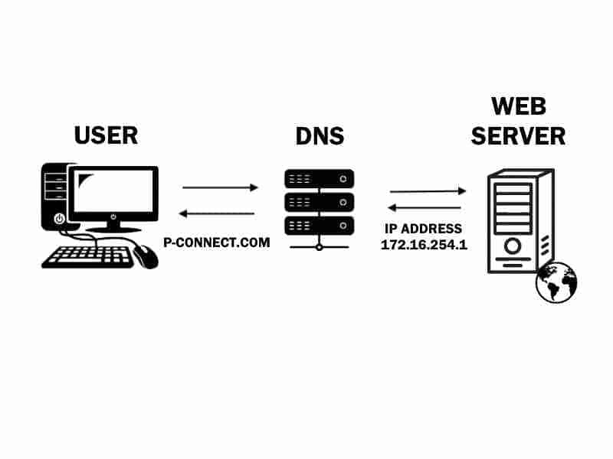
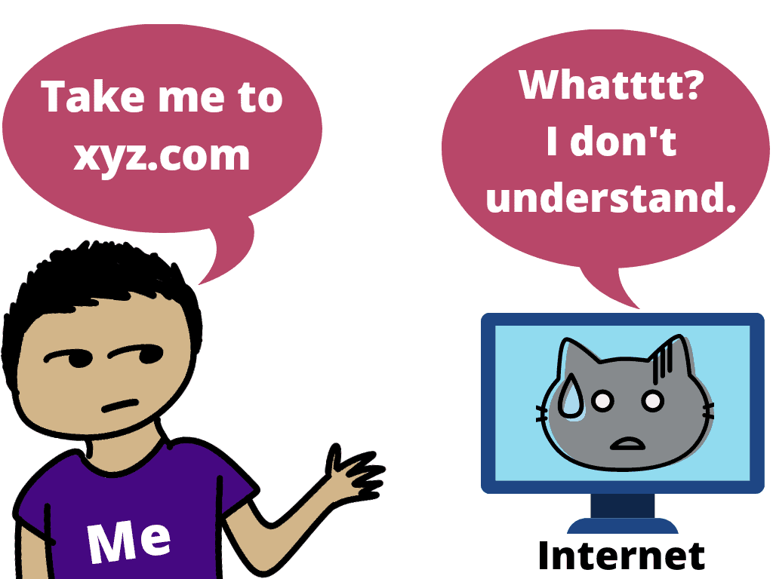
DNS (Domain Name System):

Slide 6
02
IP Address

Slide 7
IP(Internet Protocol) Address:
What is an IP Address?
IP (Internet Protocol) Address is a unique address assigned to every device connected to the internet, allowing computers to communicate with each other.
Example: 192.168.1.1 or for IPv6: 2001:0db8:85a3:0000:0000:8a2e:0370:7334.
Relationship Between DNS and IP Address:
DNS acts as a translator between domain names (which are easy for humans to remember) and IP addresses (which computers use to communicate).
Instead of memorizing a long string of numbers (the IP address), we can use domain names, and DNS resolves them to the appropriate IP addresses.

Slide 8
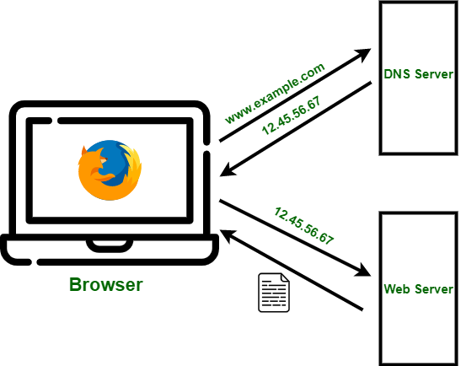
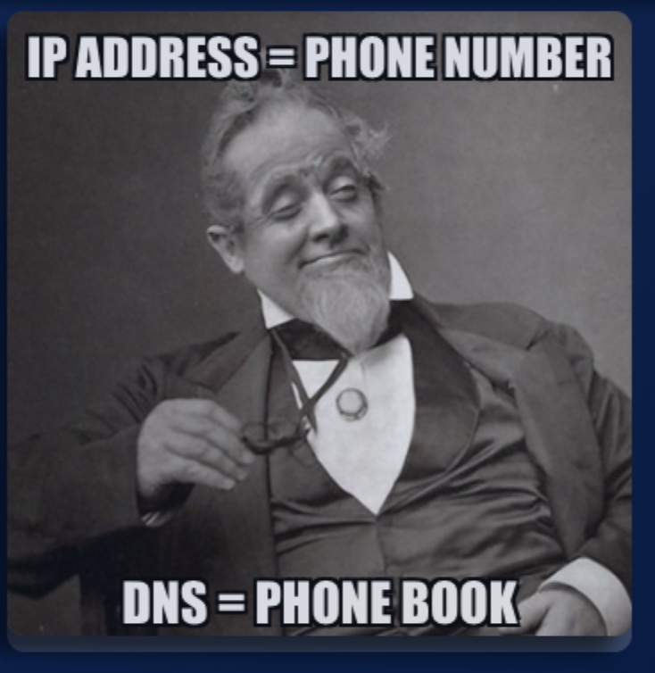
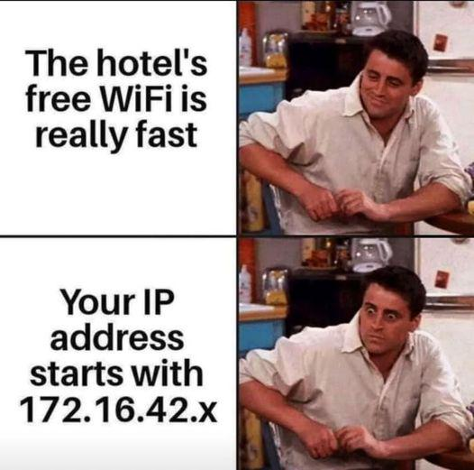
IP Address:

Slide 9
Your Public IP = My Public IP
Interesting Fact:
Your Private IP ≈ My Private IP
192.168.0._ ≈ 192.168.0._
Your private IP
My private IP
When connected to the same hostel wifi or same internet source

Slide 10
Where Domains Are Stored & How They Fetch:
Where Domains Are Stored & How They Fetch:
Where Domains Are Stored:
1) Domains are managed by domain registrars (like GoDaddy, Namecheap). When you purchase a domain, it's stored in a global database managed by the ICANN (Internet Corporation for Assigned Names and Numbers).
2) Domains are linked to authoritative DNS servers that hold the IP address and related DNS records for the domain.
How Domains Are Fetched:
1) When you type in a domain name, your browser queries DNS to find out which IP address the domain is associated with.
2) The DNS process involves checking multiple DNS servers (root, TLD, authoritative) to find the correct IP address.
3) Once the IP address is returned, the browser uses it to send a request to the web server.

Slide 11
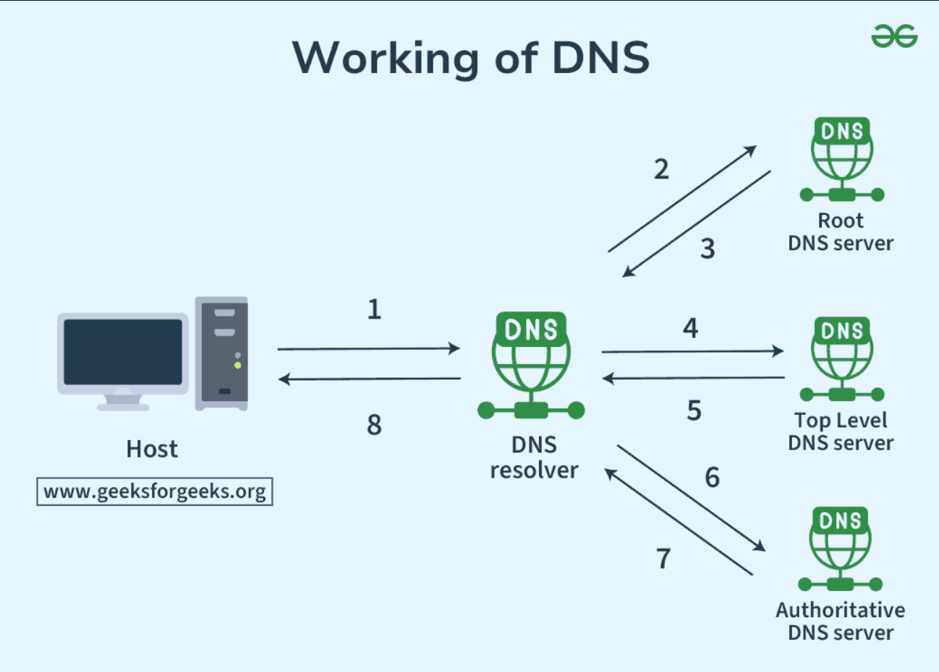

Slide 12

Summary of how the web works:
Frontend: The part users interact with (HTML, CSS, JavaScript) displayed by the browser.
Backend: Handles the logic, data processing, and connects to the database.
Database: Stores and retrieves data for the website (like user information).
DNS: Translates domain names into IP addresses, allowing browsers to find the correct web server.
IP Address: The unique numerical label assigned to each device on the internet, used for identifying the server.

Slide 13
03
VS Code installation

Slide 14
04
git Installation

Slide 15


